Slide 1
ONLINE MOBILE SHOPPING APPLICATION
TEAM
1.Buthada Siva Sai Prasad
2.Karthik Sreenivas Vurukonda
3.Mummudivarapu Narendra
4.Batchu V Naga S L Nikhita

Slide 2
PROBLEM STATEMENT
To create online mobile shopping application which provides below
functionalities.
Create and maintain Customer information.
Create and maintain Payment information
Create and maintain Order information
Create and maintain Mobile Brands information
Create and maintain Shopping Cart information
Create and maintain feedback information
Create and maintain rating information

Slide 3




ROADMAP
Application will be developed in following sprints
CORE JAVA +JPA WITH HIBERNATE
SPRING BOOT+REST CONTROLLER+JPA WITH HIBERNATE
REACT FOR UI DESIGN(FRONT END)+INTEGRATION WITH PREVIOUS SPRINT

Slide 4
PLAN
DESIGN
Generate the skeleton as per class design provides
TDD APPROACH
Identify test cases for each module
Write failing Test cases
Convert the Test cases in Green
IMPLEMENT THE CASE STUDY IN INCREMENTAL MANNER

Slide 5






USER MODULE
MOBILE BRANDS MODULE
CUSTOMER MODULE
MODULES
SHOPPING CART MODULE
PAYMENT MODULE
ORDER MODULE

Slide 6
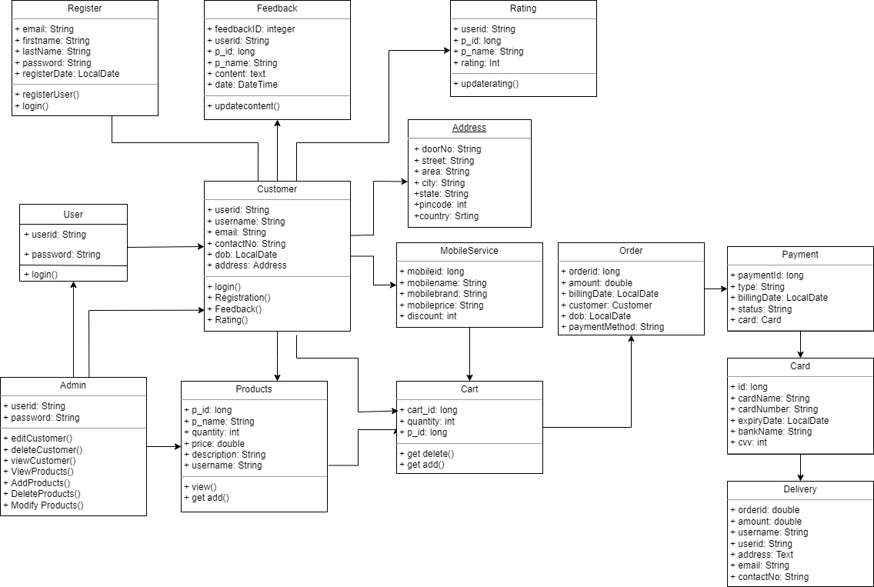
Class Design

Slide 7
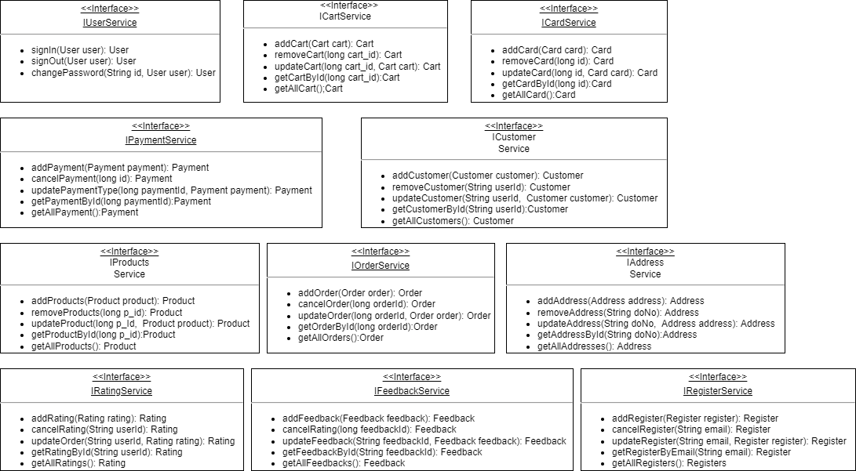
Service Interface

Slide 8
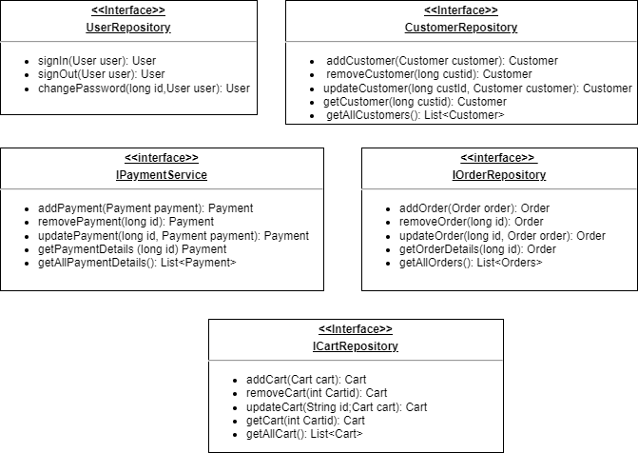
Repository:

Slide 9
THANK YOU！

